Slide 1




Powerpoint Presentation
Notes:
Photo by Andrea Piacquadio from Pexels
Content: https://prezi.com/nmedogats-xq/netflix-presentation/

Slide 2












LET US DESIGN
YOUR PRESENTATION
Trusted by

Slide 3



Want these slides
in your own branding?
Looking for a high-impact custom design?
Short on time?

Slide 4
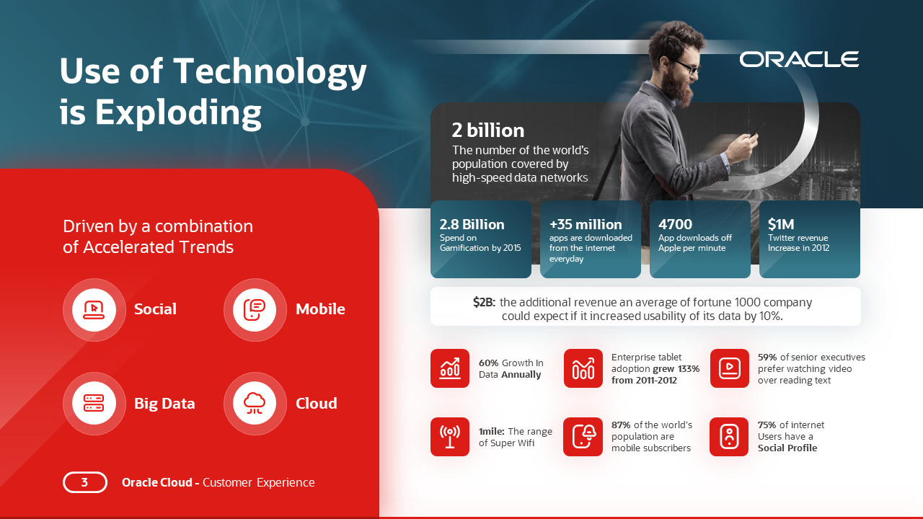

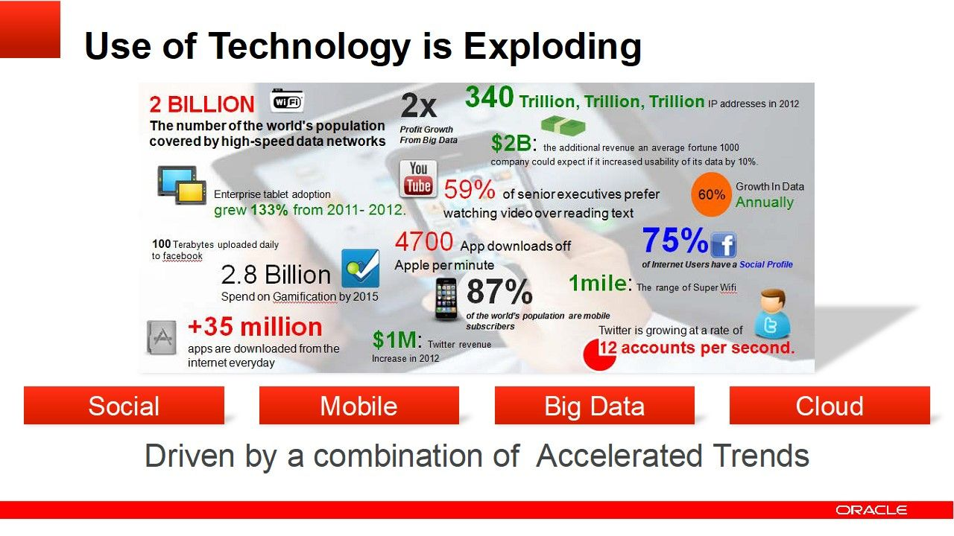
We Take Your Slides To New Heights
GO TO
24slides.com/MORE-EXAMPLES
AND SEE FOR YOURSELF!
24slides.com/MORE-EXAMPLES

Slide 5


Send Us Your Presentation Now
And Stand Out Tomorrow
STEP 1
STEP 2
STEP 3
UPLOAD PRESENTATION
REVIEW AND REVISE
DOWNLOAD & PRESENT
GO TO
24slides.com/prices
FOR MORE INFORMATION

Slide 6


What is Netflix?
Netflix is a subscription-based streaming service that allows our members to watch TV shows and movies on an internet-connected device. Depending on your plan, you can also download TV shows and movies to your iOS, Android, or Windows 10 device and watch without an internet connection.
Streaming
Entertainment
Subscription.
Notes:
Photo by JESHOOTS.com from Pexels

Slide 7

History
1997
2009
2011
Netflix was founded in 1997 by Reed Hasting and Marc Randolph as a DVD-by-mail-Service.
The company began partnering with electronics companies to get Netflix on smart TVs and gaming consoles
In 2011, the service began to acquire and produce original content, beginning with the political drama House of Cards.
In 2007 Netflix offering subscribers the option to stream some of its movies and television shows directly to their homes .
In 2010 Netflix introduced a streaming-only plan that offered unlimited streaming service but no DVDs.
Netflix racked up another quarter of impressive growth to finish 2013, surpassing 30 million paid subscribers in the United States
2007
2010
2013
Notes:
https://www.pexels.com/photo/abstract-analog-art-camera-390089/

Slide 8









Competitors
Netflix's competitors and similar companies include YouTube, hulu, Warner Media, The Walt Disney Company, Fox, NBCUniversal, Altice USA and Paramount.
Notes:
Photo by Kyle Loftus from Pexels

Slide 9

SWOT
Strength
Netflix has a large and diverse content library, with thousands of movies, TV shows, and original productions that appeal to a wide range of audiences
Threats
Weakness
Netflix faces significant competition from other streaming services, including Disney+, HBO Max, and Amazon Prime Video..
One of Netflix's primary weaknesses is its high content costs. While the company has invested heavily in original programming.
Oppurtunities
Netflix has the opportunity to expand its content offerings to international markets, especially in regions such as Asia and Africa, where it currently has limited penetration.
Notes:
Photo by fauxels from Pexels

Slide 10
How Does Netflix Work?
Content Acquisition and Licensing
Content Delivery and Streaming
Personalization and Recommendations
Payment and Subscription
Netflix obtains content from a variety of sources, including licensing agreements with movie and TV studios, original content production, and partnerships with independent producers. The company also uses its proprietary algorithm to analyze user viewing habits and preferences to inform its content acquisition decisions.
Once Netflix has acquired content, it is stored on servers located in data centers around the world. When a user selects a movie or TV show to watch, the content is streamed from the server to their device over the internet.
Netflix's algorithm is a key feature of the platform, using data on user viewing history, ratings, and search queries to provide personalized recommendations to users.
Netflix operates on a subscription-based model, where users pay a monthly fee to access the content library. Users can sign up for a variety of plans with different pricing tiers and features

Slide 11

What the Future Holds for Netflix
Netflix also has opportunities to diversify its offerings beyond traditional movies and TV shows, with plans to enter the gaming industry and expand into live events. The company's expansion into gaming could be a significant growth driver, as it would allow Netflix to tap into the massive gaming market while leveraging its existing subscriber base. Additionally, Netflix's foray into live events, such as interactive movie screenings and immersive theater experiences, could provide a new avenue for engagement with subscribers and drive brand loyalty.
Notes:
Photo by Harsch Shivam from Pexels

Slide 12

Looking for a way to entertain the whole family? Look no further than Netflix, with its vast library of family-friendly movies and TV shows that are perfect for a night in. Whether you're in the mood for a classic Disney film or a new release from DreamWorks Animation, Netflix has something for everyone. And with the ability to watch on multiple devices and with multiple profiles, each family member can find something to enjoy. So, pop some popcorn, gather the family around, and let Netflix provide the entertainment for your next family movie night!
Notes:
https://www.pexels.com/photo/happy-mother-with-children-watching-interesting-tv-program-with-opened-mouths-4474018/

Slide 13
Summary
Netflix has disrupted the traditional entertainment industry by providing a more convenient and flexible viewing experience for consumers. With over 200 million subscribers worldwide, the company has a significant customer base and continues to invest heavily in original content production and expansion into international markets.
Netflix is a streaming video-on-demand service that offers a vast library of movies, TV shows, and original productions that users can watch anytime, anywhere, on a variety of devices.
While Netflix has faced challenges, such as high content costs and intense competition from other streaming services, the company has remained a leader in the industry due to its strong brand reputation and customer loyalty.
Looking to the future, Netflix has the potential to continue to grow and innovate, leveraging its subscriber base and investments in original content and technology to stay ahead of competitors.

Slide 14


Thank
You
Notes:
Photo by Andrea Piacquadio from Pexels

